Slide 1

Generate sales leads from email conversation using AI/ML
Name : roshan Kumar Gupta
Bit Id : 2018hs70003

Slide 2
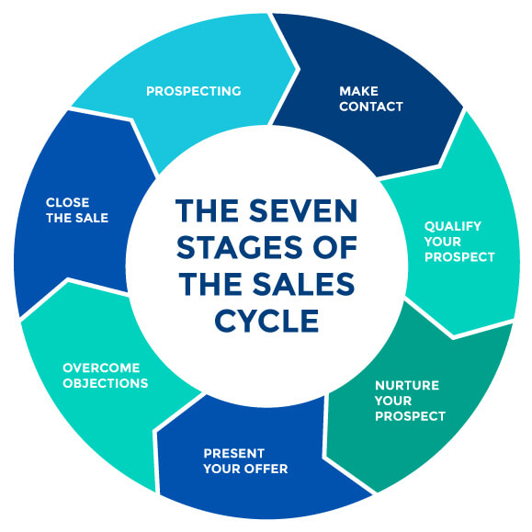
Introduction
The project is centered around the Natural language processing, uses sentiment classification on email.
The sales process, often known as the sales cycle, is the process by which your organization sells its product or service to clients
The sales team generates sales leads
The sales team approaches the leads who can become prospect.

Slide 3
Problem Statement
The sales teams conducts webinar, product session, advertisement etc.
They receive feedback from the audience in email.
Sales team manually checks the each mail and classify the leads.
Its manual work done in excel.

Slide 4
Objective of project
Reduce the time and effort of sales people
Allow sales team to make business decision quickly

Slide 5
Proposed Solution
Machine learning model trained on sales dataset to classify leads
Rest API to make inference via remote call.
UI app for configuration, analytics and representation of leads

Slide 6
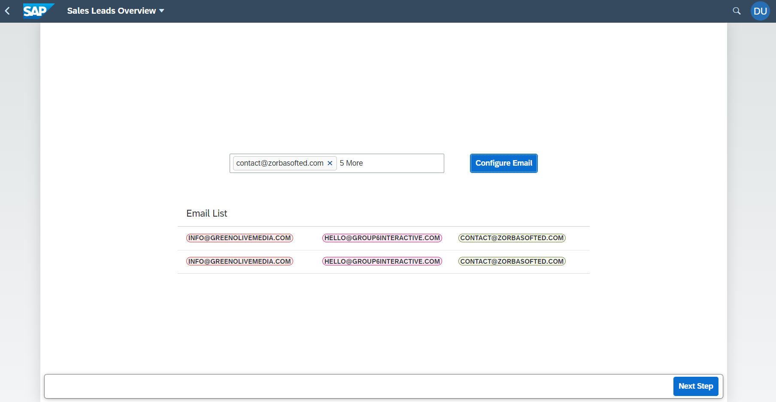
Proposed Solution
Figure : Email Configuration page

Slide 7
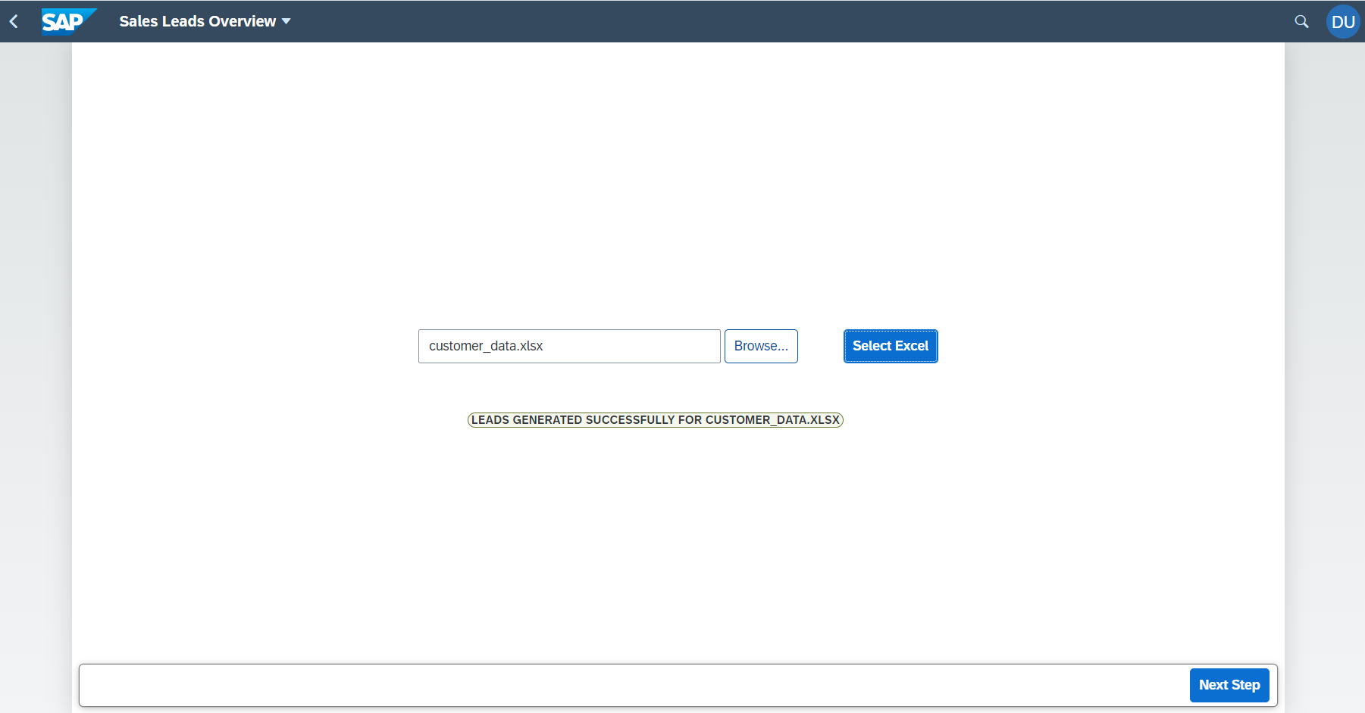
Proposed Solution
Figure : Excel uploader page

Slide 8
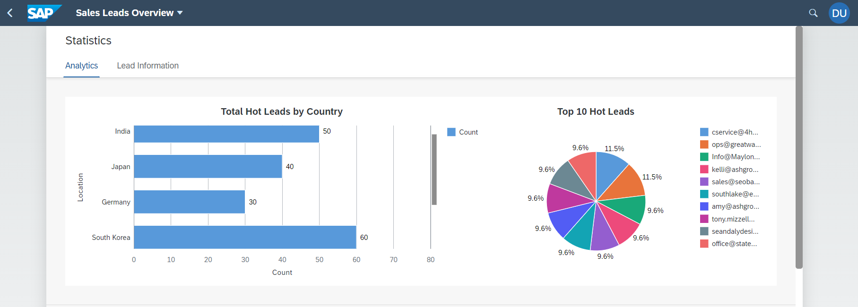
Proposed Solution
Figure : Analytics tab with charts

Slide 9
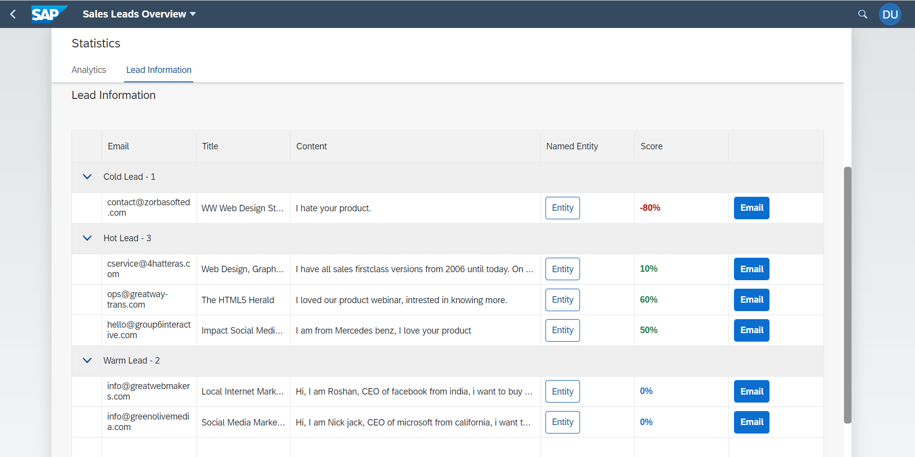
Proposed Solution
Figure : Tab for lead information

Slide 10
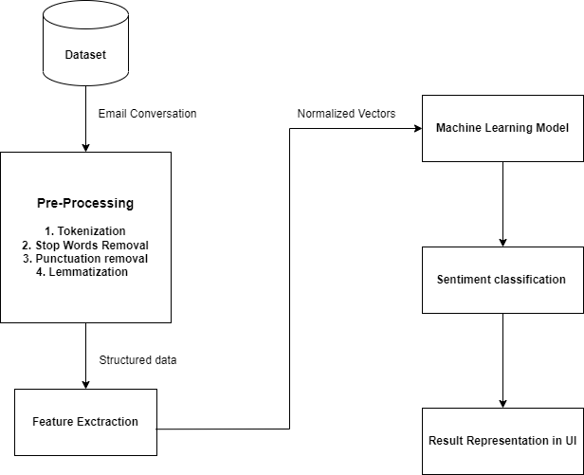
Solution Architecture
Figure : Solution Architecture of ML model

Slide 11
Benefit to organization
Reduce the time and effort for salesperson.
ML model to assist sales team.
Generate named entity recognition from emails
UI dashboard to display the model results and leads information.
Generate a template for user which can be used for sending a mail.

Slide 12
conclusion
The tech stack of this project includes python, anaconda package and UI5, An R&D and brainstorming was carried out on ML algorithms and analytical UI.
This app can be used by sales to classify leads more quickly, give them vital information from mail, decision making can be faster and reduce the manual work done by them using excel.

Slide 13

Thank You

